Slide 1

Stress detection in Students
by
Sai Priya C
Roll No. 214G1A3291
Purushotham B
Roll No. 214G1A3281
Neha C
Roll No. 214G1A3268
Tharun K R
Roll No. 214G1A32B3
Under the guidance of
Dr. P. Chitalingappa _{M. Tech., Ph.D.}
Assistant Professor
Department of Computer Science and Engineering (Data Science)
Srinivasa Ramanujan Institute of Technology
(Affiliated to JNTUA & Approved by AICTE) (Accredited by NAAC with ‘A’ Grade & Accredited by NBA (EEE, ECE & CSE)
Rotarypuram Village, B K Samudram Mandal, Ananthapuramu – 515701.
2024 - 2025

Slide 2
Abstract
This study leverages machine learning to detect stress in students using physiological and behavioral data such as heart rate variability, sleep patterns, physical activity, and academic workload. Data is collected through wearable sensors, self-reports, and digital activity logs, then processed by models like Support Vector Machines, Random Forests, and Neural Networks to classify stress levels into low, moderate, or high categories. The system helps monitor stress in real time using mobile apps or academic portals and offers personalized stress management tips. Preliminary results demonstrate high accuracy, suggesting its potential to enhance student mental health, academic performance, and overall well-being..

Slide 3

Contents
Abstract
Introduction
Literature survey
Proposed Work
References
GitHub Link
Queries

Slide 4
Introduction
Stress is often associated with negative experiences or events. However, research shows that stress is a natural part of life.
Some common causes of stress Work-Related Stress, Academic Stress, Financial Stress, Personal Relationships, Health-Related Issues.
Every hour, a student commits suicide in the different part of the country. Our country has reported large suicide cases of the youngsters aging between the age group of fifteen to twenty nine, as per Lancet report(2012).
Number of suicide in our nation are increasing Consistently around 92 individuals commit suicide around the world, which makes it 800,000 for every year. Out of this 135000 (17%) are an inhabitant of India.
We will study how these factors affect people's minds using brainwave signals collected from the PSS dataset.

Slide 5
Introduction
Application and Impact: Real-time monitoring and early detection of stress allow timely interventions, improving student well-being and academic outcomes through personalized support.
Future Directions: The project aims to refine model accuracy, expand data sources, and address ethical considerations such as privacy and data security to ensure effective and responsible deployment.

Slide 6
Literature Survey
No | Title | Author | Journal Name & Year | Methodology Adapted | Key Findings | Gaps
1. | Stress detection in students | Ravinder Ahuja , Alisha Banga | Elsevier Ltd 2019 | Machine Learning Techniques | Classification ,Mental Stress, Percieved Scale | Exploring these models on a diverse datasets
2
3
4
5
No | Title | Author | Journal Name & Year | Methodology Adapted | Key Findings | Gaps
1. | Stress detection in students | Ravinder Ahuja , Alisha Banga | Elsevier Ltd 2019 | Machine Learning Techniques | Classification ,Mental Stress, Percieved Scale | Exploring these models on a diverse datasets
2 | Stress detection in students | Ashutosh Singh, Amit Kumar | INCET 2024 | Machine Learning Techniques | Stress, Support Vector Machines | Applying models to diverse datasets
3
4
5

Slide 7
Proposed System
In this Project we will use Machine Learning to identify stress level in the students and to predict the stress earlier so that we can able to stop the major damage to their life before happening.
In the test, we will evaluate students amongst different situations. the level of stress was approved by the undertaking execution.
The proposed model includes PSS dataset collection , pre processing , feature extraction and applying machine learning algorithms.
Raw Data -> Pre-Processing of data -> Applying different classification algorithms -> Output.

Slide 8
Reference
[1]. Ravinder Ahuja and Alisha Banga, “Mental Stress detection in students”,Elsevier Ltd , vol. 11, pp. 349-353, Jan. 2019.

Slide 9
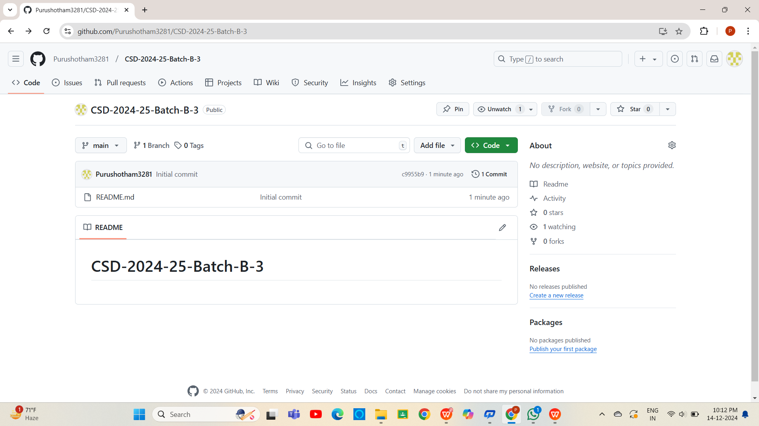

Git Hub Dashboards of each student

Slide 10
Any Queries?

Slide 11
Thank You!!!

